Slide 1
RTO Management System
Software Engineering & Project Management
Semister - IV
Group Project

Slide 2
Group Members
S. No. | Name | Registration Number | Role
1 | S Anish Kumar | RA1911003010641 | Leader
2 | Jeremiah Nathan Nunes | RA1911003010645 | Member
3 | Akshat Agarwal | RA1911003010646 | Member

Slide 3
Introduction to our Project
RTO Management System will be a system menu-driven software for the hassle-free management of vehicles registered under the RTO.
With minimal steps and maneuver to the desired function by the user, this system will highly minimize the confusion.
With clear options and smooth interface, it enables editing, modifying, adding, removing and overall managing of any vehicle registration with full details on the vehicle owner, their address and other things.
Easy access to all services and facilities offered by the system will increase the RTO efficieny by many folds.
The program is enabled to retrieve and access information from a given RTO database and also edit its content at all points of time.
With a clearly specified working description and a menu manual, even a user with zero prerequisite knowledge on the subject will be able to access all the functions of the program.

Slide 4
Problem Statement & its Effects
Faulty and Rugged RTO Management Software with complicated access and functioning compatibilities; resulting in ineffecient services and loss of tme.
Slow and Dull admin login websites at RTO due to tons of stagnant data stored daily.
Confusing and unclear functions on site resulting in improper service, leading to waste of time and resources.
Multiple and duplicate accounts getting created without a proper check, facing cancellation and penalty.
Long lines and hefty paper works, resulting in illegal vehicle registrations as a alternative for people.
Unsystematic procedure in services creating disarray in people and officials irrespective of the user.
Faulty and unsorted databases hindering services due to unsynched softare updates.

Slide 5


Project Benefits
1
Increasing the rate and efficiency of Vehicle registration related services at a RTO.
Making user interface very simple to facilitate effortless work flow and removing the complexity factor in the system.
2
Making people more willing to visit an RTO legally, appreciating the faster service rate and efficiency.
Easy differentiation between normal and authorized services at an early stage to minimize time consumed.

Slide 6




A
Easy differentiation between normal and authorized services at an early stage to minimize time consumed.
Negation of repeated and long procedures in a service by intelligent handling of user’s interest.
The project will facilitate even zero pre-knowledge users to understand the system easily by just readin the working manual.
Ultimately, decreasing bribing at RTO and malpracatises checked due to overall easy availability of services.
B

Slide 7

Functional Requirements
Requirement (#) | Requirement Specification | Department | Name of Business User | Status
E1FR1 | License Application : Any authorized user can upload a form for license application. | Front-end | Anish Kumar | Done
E1FR2 | •Vehicle Registration: Authorized user can register the vehicle by uploading the form for vehicle registration. | Front-end | Anish Kumar | Done
E1FR3 | Mail : Administrator can send message to the authorized user regarding the license renewal and all. | Management | Akshat Agarwal | Done
E1FR4 | Search: Administrator and authorized user can select a particular vehicle and license holder by using license number, vehicle number, or colour. | server | Jeremiah Nunes | Done
Our system has mainly three modules, an administration module, an authorized user module, and other user module. Various processes involved in these three modules are as follows:

Slide 8
Non-Functional Requirements
Requirement (#) | Category of NFR | Requirement Specification | Department | Name of Business User | Status
NFR1 | Performance | All pages should load within 3 seconds | Server | JeremiahNunes | Completed
NFR2 | Performance | Search should bring the results less than 7 seconds | Server | Anish Kumar | Completed
NFR3 | Availability | Application should be available for 24x7 | Server | JeremiahNunes | Completed
NFR4 | Scalability | Registration Service should scale to serve 1000 request per second over 5 minutes timespan | Database | AkshatAgarwal | Completed
NFR5 | Confidentiality | All data should be encrypted. | Database | AkshatAgarwal | Completed
NFR6 | Usability | Application should work on all devices | Front End | Anish Kumar | Completed
NFR7 | Security | Verify users before giving access. | Front End | Anish Kumar | Completed
NFR8 | Flexibility | Should be User Friendly | Front End | AkshatAgarwal | Completed
NFR9 | Extensibility | Service should be available to all RTO officials of India | Management | Jeremiah Nunes | Completed

Slide 9
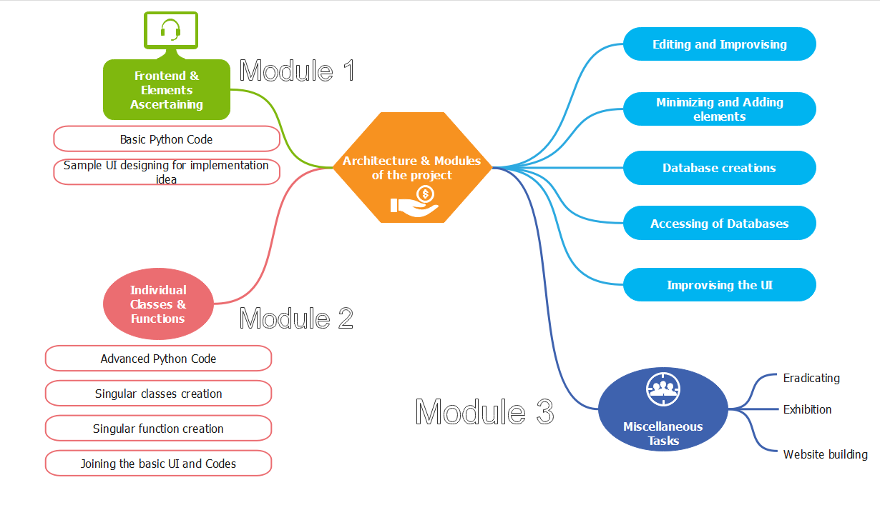
Project Design

Slide 10
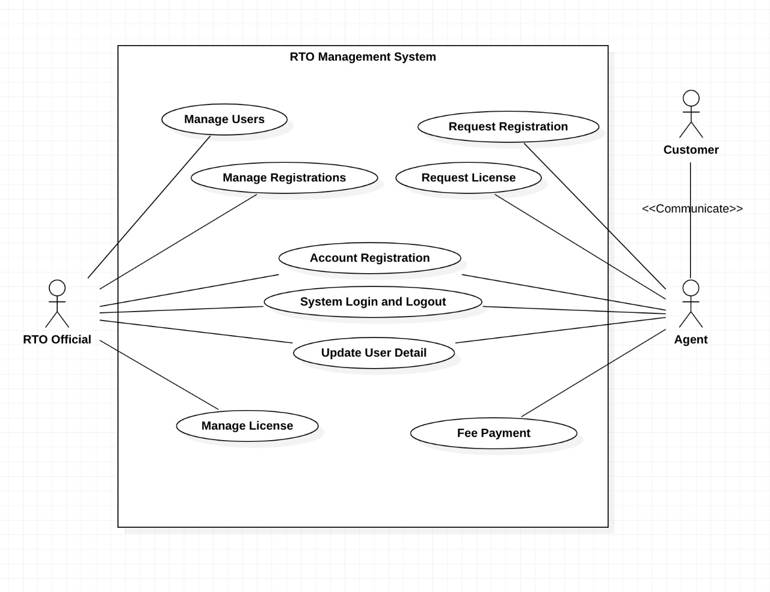
Use Case Diagram
This is the UML use case diagram for RTO Management System
RTO official (Admin) : Manage users, Manage Registrations, Account Registration, System Login and logout, Update User details, Manage license
Agent : Request Registration, Request license, Account Registration, System Login and logout, Update User details, Fee Payment, communication with customer

Slide 11
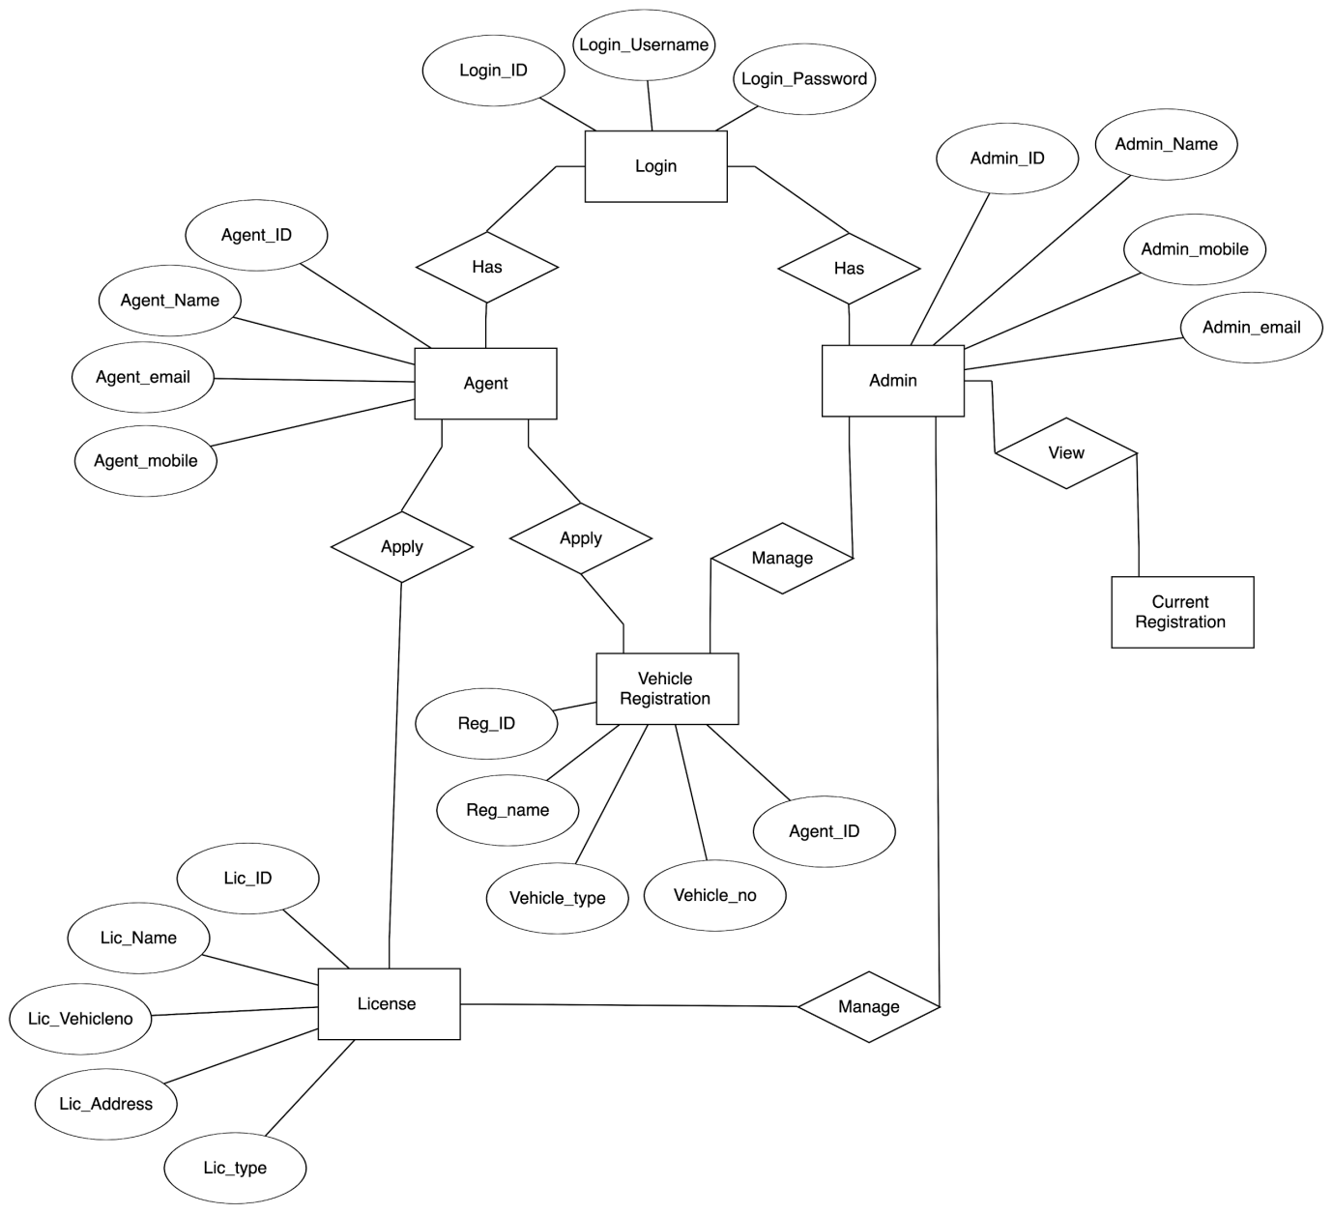
ER Diagram
This ER (Entity Relationship) Diagram represents the model of RTO Management System.
RTO Management System Entities and Attributes :
Agent Entity : Agent_ID, Agent_Name, Agent_email, Agent_mobile
Admin Entity : Admin_ID, Admin_Name, Admin_email, Admin_mobile
Login Entity : Login_ID, Login_Username, Login_Password
Vehicle Registration Entity : Reg_ID, Reg_Name, Agent_ID, Vehicle_No, Vehicle_type
License Entity : Lic_ID, Lic_Name, Lic_Address, Lic_type, Lic_vehicleno

Slide 12
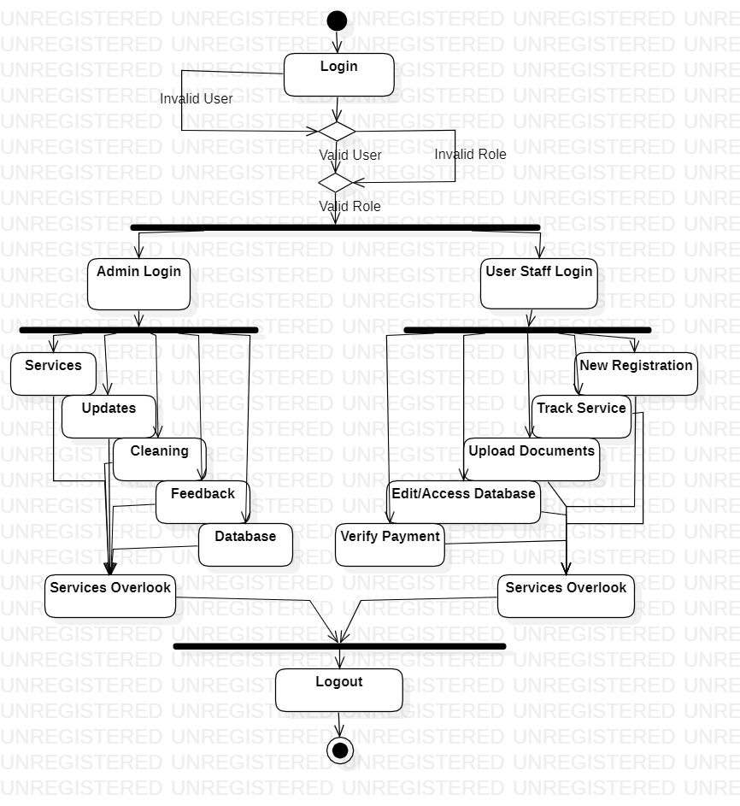
Activity Diagram

Slide 13
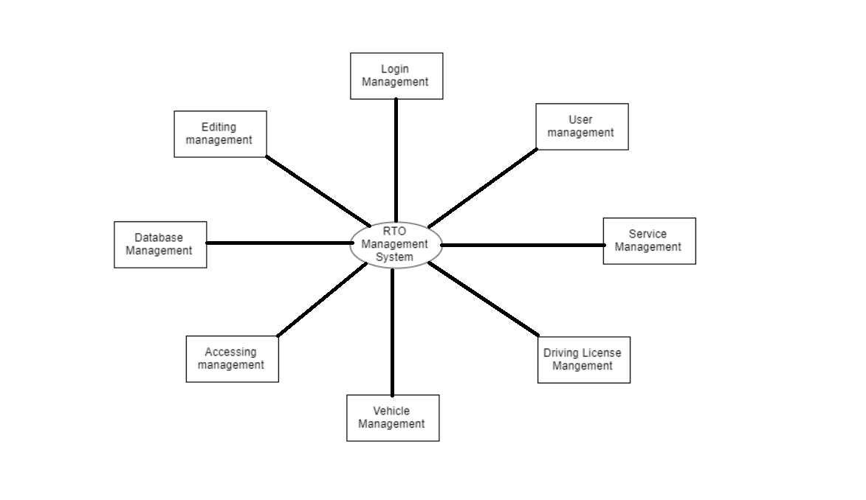
DFD Level 0 Process
This is the first level DFD of RTO MANAGEMENT SYSTEM where we have elaborated the functions and services related to our software.It outlines the modules used in our project.The processes are:
➢User management
➢Service management
➢Driving License management
➢Vehicle management
➢Database management
➢Accessing management
➢Editing Management
➢Login Management

Slide 14
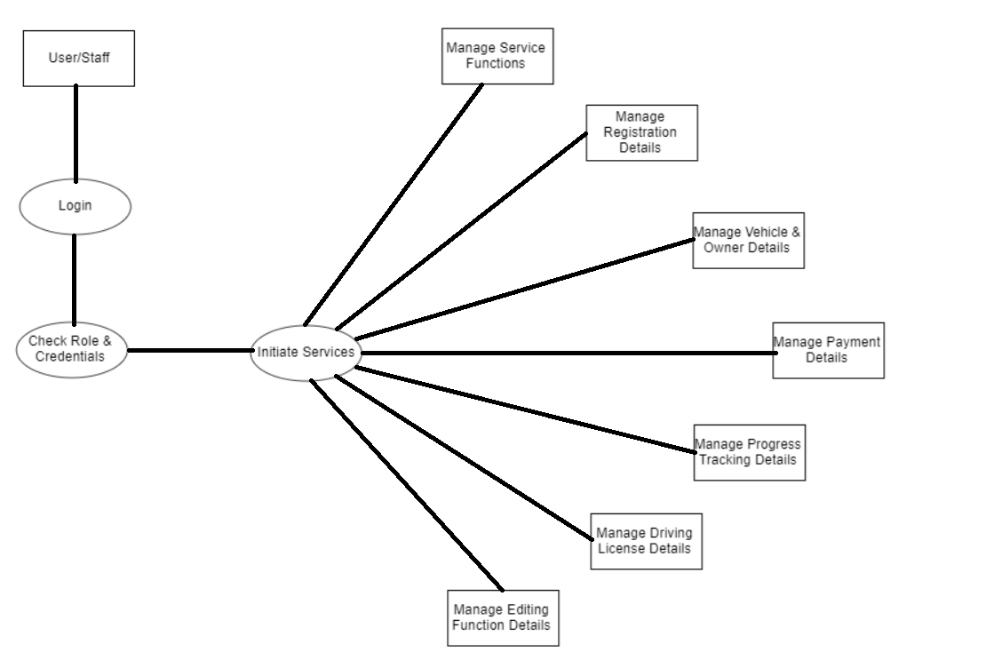
DFD Level 1 Process
This is the second level DFD of RTO MANAGEMENT SYSTEM where we have elaborated the main functionality or subprocess of our software.
The processes includes:
➢Managing Service and functions of the options available
➢Managing User Registration and Customer Registration
➢Managing Vehicle Owner information
➢Managing Payment for the service initiated
➢Managing Progress and tracking of service
➢Managing Driving License related details
➢Managing Editing and accessing of database

Slide 15
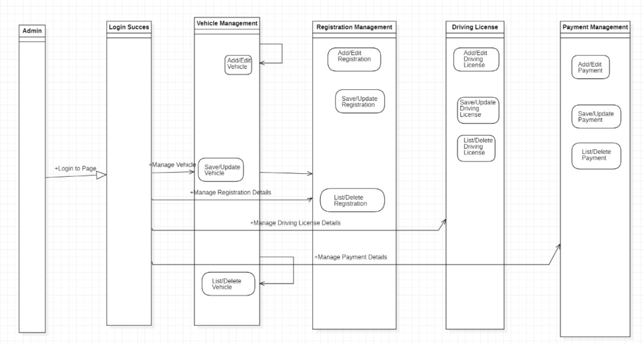
Sequence Diagram
1.Login Success:Users login details are cross verified from the database.
2.Vehicle Management:User can edit or add additional vehicles according to their requirements.As well as listing and deleting vehicles.
3.Registration Management:User will be able to add their registrations and edit/update their old or wrong details.
4.Driving License:Driving license details can be added and edited if required by user.
5.Payment Registration:User can view their pending dues or payments required for various services.They can view past payment records as well.

Slide 16
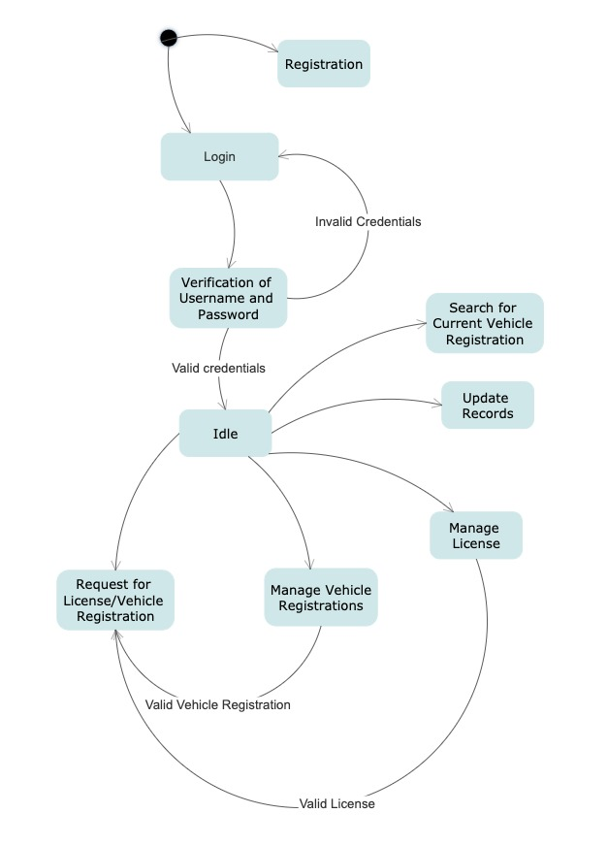
State Diagram
These are the different pluaisble states in the progression of the working of the website.
Among all the miscellaneous services and editiong pages, we have shortlisted the main diverfication points in the state flow of the functions available for the website.
Registration and Login of the User Staff as well as the Server Maintainance Admin Staff is considrede the most imortant primary states in the initiation of any service.
Other updating, editing, requesting services regarding vehicle, owners and apllicants data are also the next important bufurcations holding poits in the state flow.

Slide 17
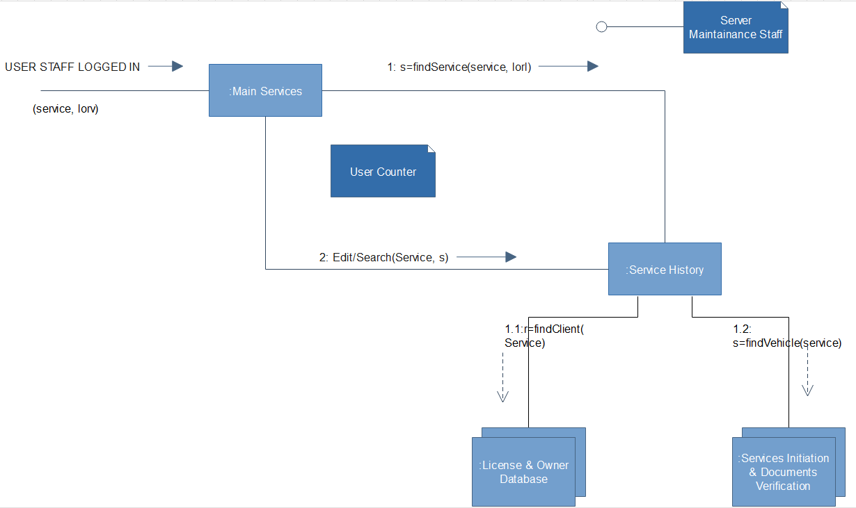
Collaboration Diagram
The main class function in the program which carry the important instances regarding editing, updating, viewing and initiating of services and requests are mentioned.

Slide 18
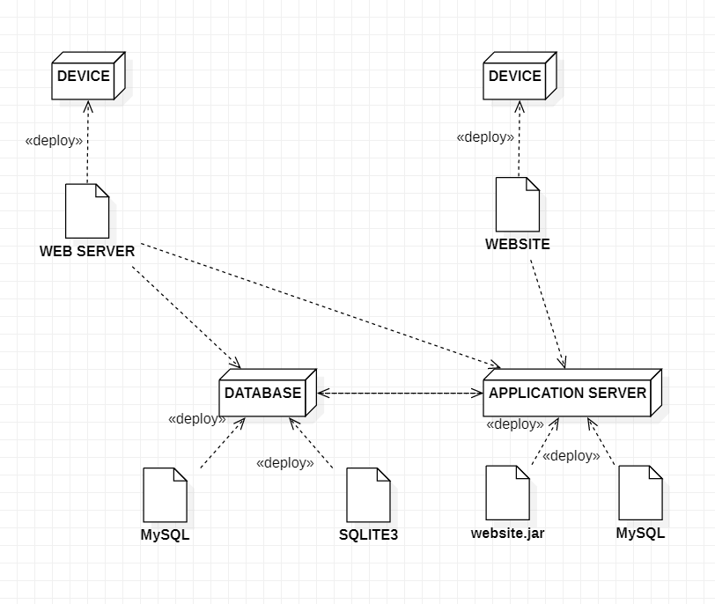
Deployment Diagram
This the deployment of data and instances between the differnet apllications and servers from the main speculated devices for a simple example.
The main devices of user staff and admin will be havng the total control.
The database and website applicatiosn will be directly under them for editing, reviewing and use for service.

Slide 19
Module 1
We have four basic goals for the first module’s implementation.
The sample UI and the frontends, are designed to ascertain the plausible funtions and services to be involved in the code.
Mainly the login and registratin portals for the admin and user staff are considered.
Their joining code in python for the working and implementaion are finalized.
This step will facilitate the further UI designs to base the classes and fucntions to be needed in the service initiation portals.
Further, we are adding the sample UI which are considered for the following programs to be presented after it.

Slide 20
Sample UI & Front-end

Slide 21
Module 2
Variables and items creation to be stored in the database and taken as input from the user.
System functions which are menu driven and connect the different windows.
System reports and notifications, enabled messageboxes for better User Experience.
Paid services and fees calculation module integrated in all windows

Slide 22
Complete Front-end & Function Creations

Slide 23
Module 3
70%
60%
50%
40%
A final progress report of the different services installed in the system.
Databse creation and storage with all systems and fucntions.
Connection of the databse with the entry values in all the interface windows.
Database editing and resetting options to be availed to the user.
Miscellaneous helping wodgets and messageboxes for proper database scheduling.
We are enclosing the databases and table creations of all the service portals of the system.

Slide 24
Database Connection & Miscellaneous tasks

Slide 25
Testing Details & Master Test Plan
The project has finally ended in its production phase, now the last step is to test every part of the project, both code and UI to get an indispensable final product.
We will ascertain the test objectives and frame the test cases from them.
We will enact the test cases and make a result dump for further modifications in it.
Performance under multiple launches and parallel entries
Working under non-matching data types for the entry
User ans admin database registrations
Vulnerability checking in all buttons-
1.Submit
2.Update
3.Reset
4.Exit

Slide 26
Test Cases
Different data types in login and registration
Different data types in entries and search sections
Multiple window launching checks
Multiple window launching checks
Accept Valid login and registration details.
User clicks on User Registration link Enter the valid credentials Click Register /login button
User should be taken to the next page for entering more user details
Accept only the specified data types in the entries section
User enters different values in the entry box Exact message boxes are delivered for matching inputs
User should be prompted to do the needful
Two or more bifurcations are launched simultaneously.
Vehicle and driving license portals are launched simultaneously.Inputs are made correspondingly
User should be barred from doing it followed by a prompt.
All buttons are checked for all cases, which will in return check the driver coed itself.
The main 5 buttons are tested for all types of casesCorrects message boxes are appearing or not are checked.
User should be prompted to do the needful if done wrong.
SUCCESS
SUCCESS
SUCCESS
SUCCESS

Slide 27
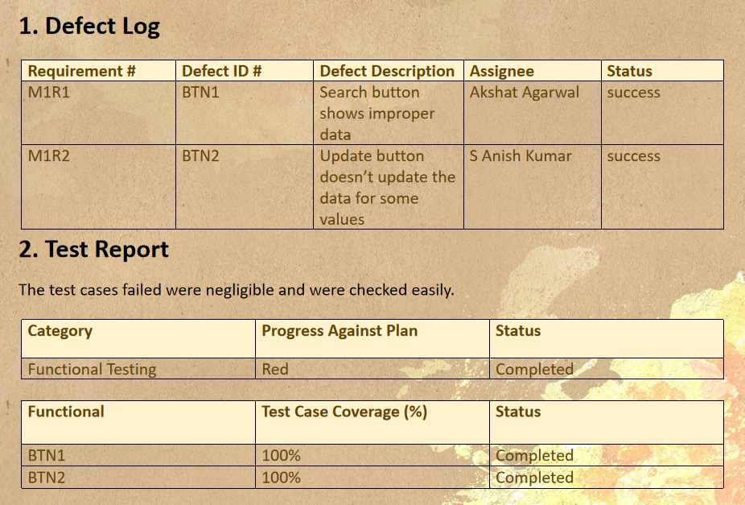
Defect Log & Test Report

Slide 28
Thank you
RTO MANAGEMENT SYSTEM
Working Students-
S Anish Kumar
Akshat Agarwal
Jermiah Nathan Nunes
Guiding Faculty-
Dr. K. Arthi

